Slide 1
Structured Programming
Techniques

Slide 2
introduction

Slide 3
Structured programming is a programming paradigm aimed at improving the clarity, quality, and development time of a computer program by making extensive use of the structured control flow constructs of selection (if/then/else) and repetition (while and for), block structures, and subroutines.

Slide 4
Structured Programming

Slide 5
In structured programming, we sub-divide the whole program into small modules so that the program becomes easy to understand.
The purpose of structured programming is to linearize control flow through a computer program so that the execution sequence follows the sequence in which the code is written.
The dynamic structure of the program than resemble the static structure of the program. This enhances the readability, testability, and modifiability of the program.
This linear flow of control can be managed by restricting the set of allowed applications construct to a single entry, single exit formats.

Slide 6
Why we use Structured Programming?

Slide 7
We use structured programming because it allows the programmer to understand the program easily.
If a program consists of thousands of instructions and an error occurs then it is complicated to find that error in the whole program, but in structured programming, we can easily detect the error and then go to that location and correct it.
This saves a lot of time.

Slide 8
Types of Structured
Programming

Slide 9
Structural Programming

Slide 10
This is the first programming approach used widely in beginning.
The program is divided into several basic structures called building blocks :
(1) Sequence Structure
(2) Selection or Conditional Structure
(3) Repetition or loop Structure

Slide 11
Sequence Structure

Slide 12
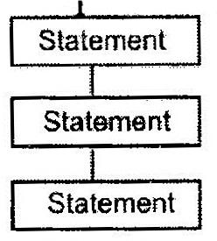
This module contains program statements one after another. This is a very simple module of Structured Programming.

Slide 13
(2) Selection
or Conditional Structure

Slide 14
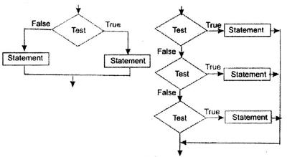
The Program has many conditions from which correct condition is selected to solve problems.

Slide 15
(3) Repetition or loop Structure

Slide 16
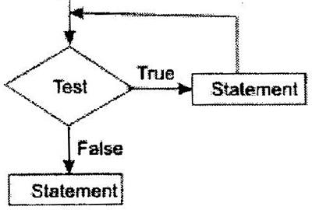
The process of repetition or iteration repeats statements blocks several times when condition is matched, if condition is not matched, looping process is terminated

Slide 17
Modular Designing

Slide 18
In modular approach, large program is divided into many small discrete components called Modules. In programming language, these modules are called function or subroutines.
Modules are debugged and tested separately and combined to build system.

Slide 19
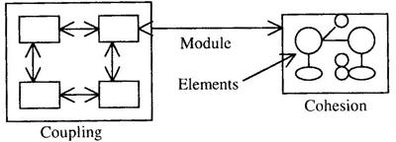
The evaluation of modeling is called coupling and cohesion. The module coupling denotes number of interconnections between modules and module cohesion shows relationship among data or elements within a module.

Slide 20
Top Down Designing

Slide 21
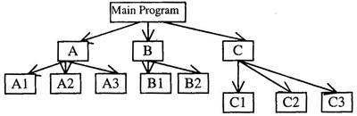
The large program is divided into many small module or subprogram or function or procedure from top to bottom.
Top module is tested first, and then sub-modules are combined one by one and tested.

Slide 22
The main program is divided into sub-program A, B, and C. The A is divided into subprogram A1, A2 and A3.The B is into B1, and B2. Just like these subprograms, C is also divided into three subprogram C1, C2 and C3. The solution of Main program is obtained from sub program A, B and C.

Slide 23
Bottom Up Designing

Slide 24
In this approach designing is started from bottom and advanced stepwise to top. So, this approach is called Bottom up approach.
At first bottom layer modules are designed and tested, second layer modules are designed and combined with bottom layer and combined modules are tested. In this way, designing and testing progressed from bottom to top.

Slide 25
